Slide 1
Capstone
Happiness Plus 1
A game by Jeff Redmond
https://github.com/jeffredmond/Ense400

Slide 2
What was my capstone?
Happiness plus 1 is a single player, 2D, top down view, puzzle solving, Role playing game
The story of the game is about a character who has fallen into an unfamiliar world and the only way for them to get out is to for them to help the people in the world remember their pasts. Helping the other characters in turn makes you feel happier and increasing your characters happiness causes you to ascend to the next level. As the levels progress your character begins to remember more of their own past and how they ended up coming to this world in the first place.
Problem that I am trying to solve
People have too much free time and money
Need games to fill their time and to spend their money on

Slide 3
Break down of last two semesters
Fall semesters was spent doing:
Writing the first draft of the Script
Creating NPC Profiles/rough sketching them out
Creating Lofi levels
Storyboarding NPC interactions with the player
Started working with GameMaker studio 2 to create the game.
Created player, game, inventory, and menu objects.
Created a object for talking to NPCs
By the end of november had a working demo

Slide 4
Break down of last two semesters
Winter semesters was spent doing:
Created player walking animations and had a system to build new characters easily
Created an object that would create and control cutscenes
Added save and load functionality
Added room transfer objects
Overhauled the object for talking with NPCs
Added an object responsible for interacting with puzzle items
Added an object responsible for scenery that had descriptions
Created the first two levels
Drawing all the backgrounds
Drawing all the scenery
Drawing all the puzzle items
Creating all the cutscenes
Create the music for the tile screens and intro cutscene in FL studio

Slide 5
Software methodology used
Agile method was used:
Fall semester we used bi-weekly sprints
Start of winter semester was still bi-weekly sprints that then degraded into weekly then this last month or so every few day sprints
To keep track of these sprints it started off with a google drive document keeping track of task and current progress and new up and coming tasks. Tasks were scheduled using a homemade gantt chart.
However after my project partner dropped out I then used a onenote to keep track of progress.
This oneNote also kept track of any major bugs (bugs that took longer than 10 minutes to fix)
Revision control
Used github

Slide 6
Main features of the game
Game maker is built on self contained objects.
I will briefly go into all the objects and systems used in the game.

Slide 7
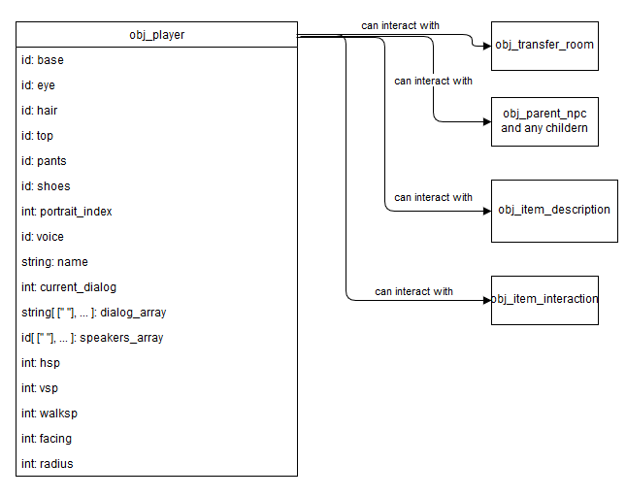
Main objects and systems implemented
Player object

Slide 8
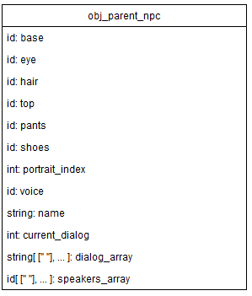
Main objects and systems implemented
NPC parent object

Slide 9
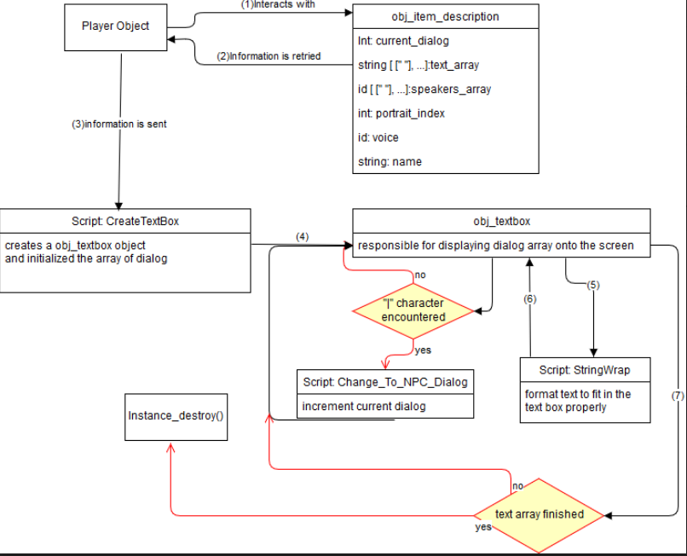
Main objects and systems implemented
NPC interaction and the textbox object

Slide 10
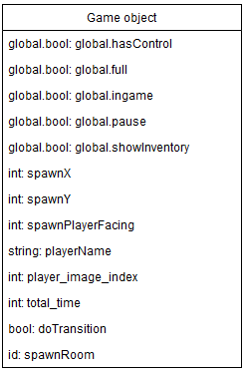
Main objects and systems implemented
Game object

Slide 11
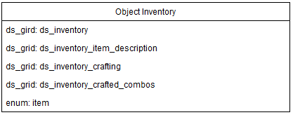
Main objects and systems implemented
Inventory object

Slide 12
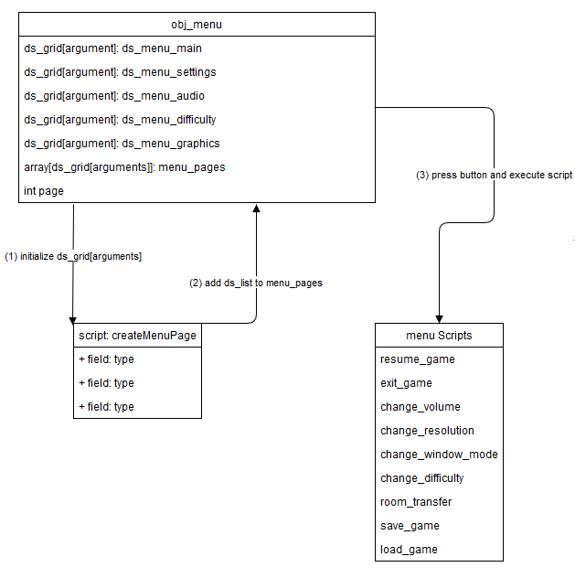
Main objects and systems implemented
Menu object

Slide 13
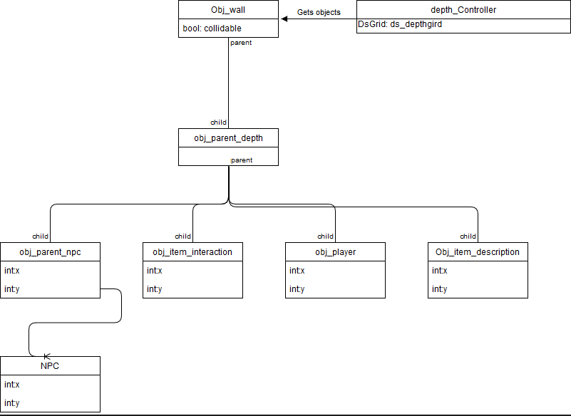
Main objects and systems implemented
Depth controller object

Slide 14
Main objects and systems implemented
Room transfer object

Slide 15
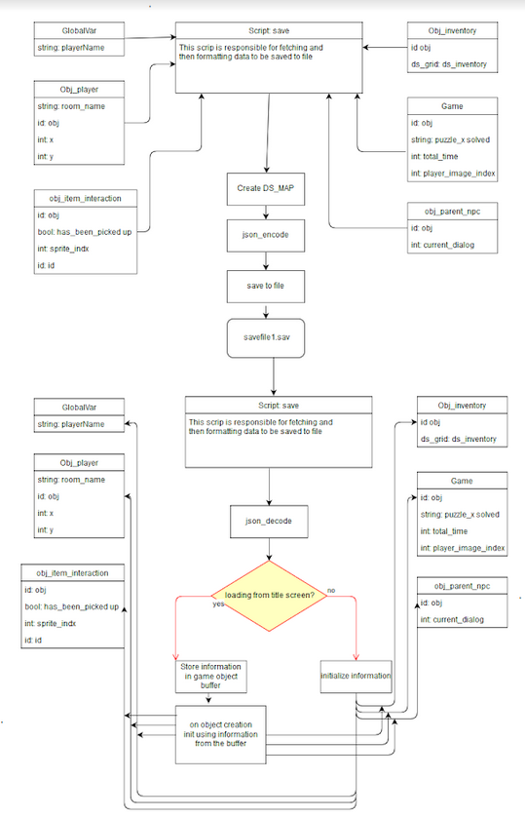
Main objects and systems implemented
Save load systems

Slide 16
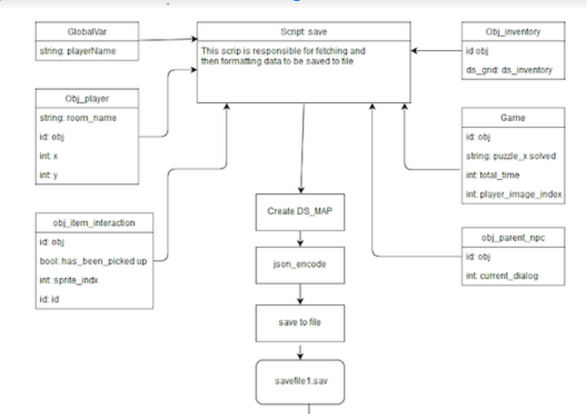
Main objects and systems implemented
Save load systems

Slide 17
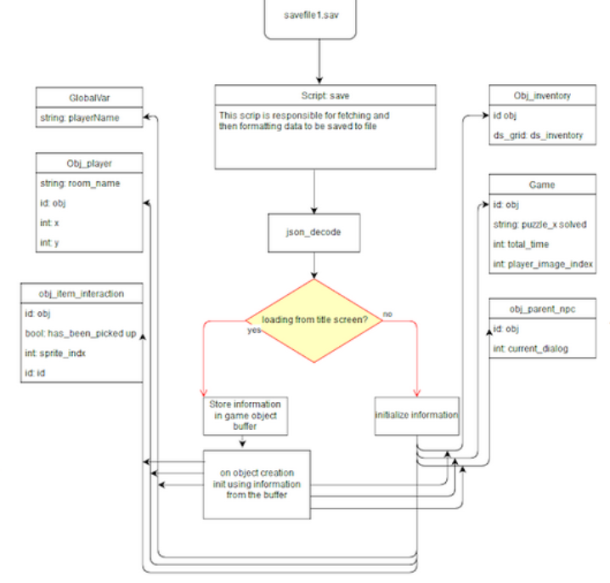
Main objects and systems implemented
Save load systems

Slide 18
Main objects and systems implemented
Cutscene objects (including cutscene trigger object)

Slide 19
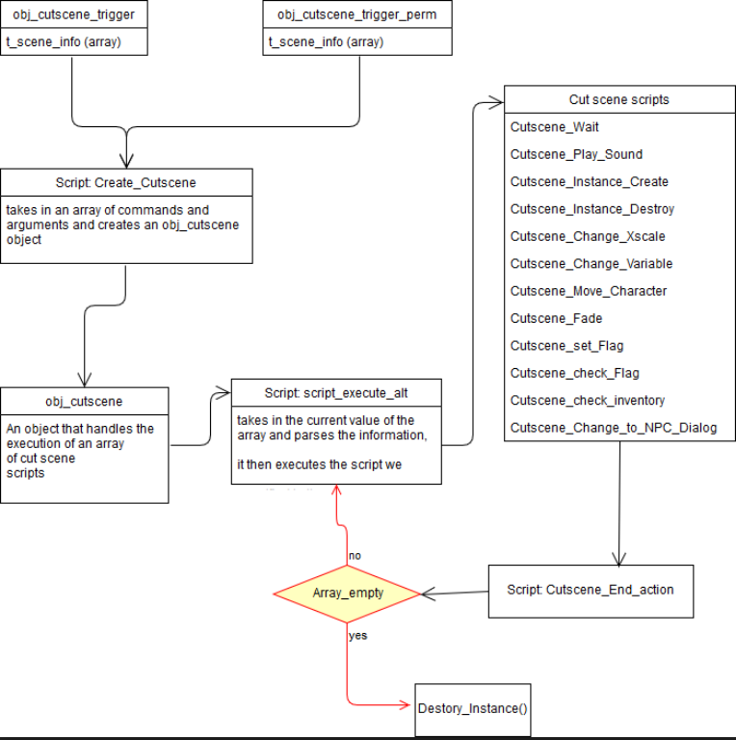
Main objects and systems implemented
Cutscene objects (including cutscene trigger object)

Slide 20
Main objects and systems implemented
Item interaction and item description objects

Slide 21
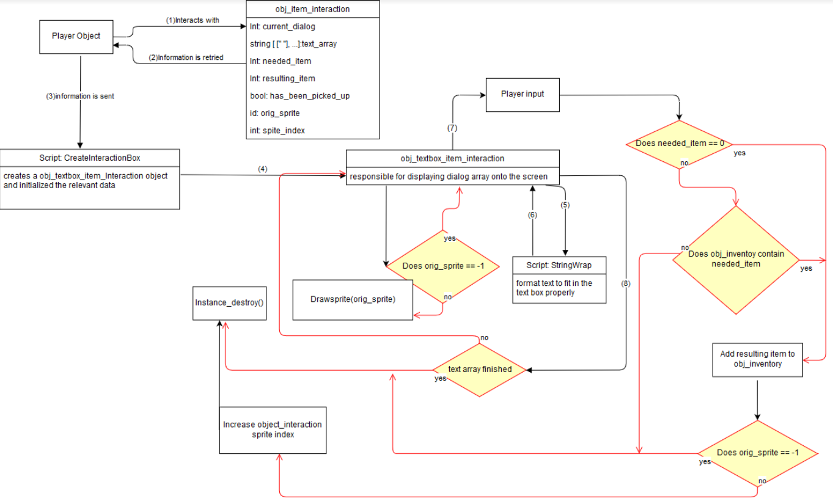
Main objects and systems implemented
Item interaction and item description objects

Slide 22
Quick overview of Testing
Before the game had been created I set up where all the elements and outcomes for the first two puzzles were written on queue cards and then the tester attempted to solve the puzzle on their own and i would direct them. After that they gave feedback on the puzzles.

Slide 23
Quick overview of Testing
After the completion of each major object and system I created a list of manual tests for integration testing. Here is an example of a few tests I would check against for the saving system
Does saving in the room work?
Does loading from within a room work
Does loading with no save file cause no issues?
Does loading from title screen work properly
Do all obj_interaction instances contain the proper item status?
Do all obj_npc instances contain the proper dialog state?
Does the inventory contain the proper information after loading?

Slide 24
Quick overview of Testing
Had my roommates play the game these last two weeks and act as beta testers then document what bugs they found. I also asked for feedback about the story, I will use the information they told me as i continue working on this game. But for now it will stay as it was for project day.

Slide 25
What was proposed but not achieved
I had proposed to have completed 6 levels
Ended up have the first level completed and the second level ¾ completed.
This was due to unfamiliarity with the program.
Poor understanding of how long certain task would take to complete. I.e. i thought the save system would be able to be completed in under a week. Ended up taking over a month and a half to get it where it is currently.
Took longer to create objects that were scalable and more robust
Game music for each level and sound effects
Making music is easy, making good music is not so easy.
Ended up only having music for intro and title screen
Creating scenery takes a lot longer than you would think

Slide 26
Future goals for the game
Step 1
I want to complete the game completely
Rough estimates that I have say that it would take maybe another 200 - 300 hours to finish.
Step 2
Put the game on steam
Step 3
Profit($)

Slide 27
Questions
I need computers for tomorrow.

